Slide 1

17 May 2025
COMPUTER SCIENCE AND ENGINEERING.
TEAM 11
W.Karishma
S.Vishali
J.S.Maryam shafa

Slide 2


BLOOD GROUP DETECTION USING FINGERPRINT

Slide 3

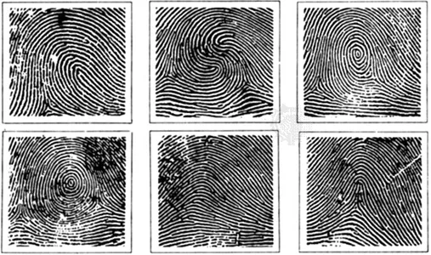
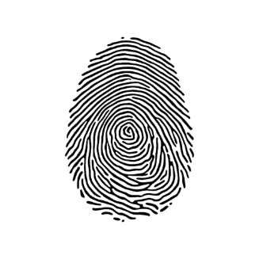
Abstract
2

Slide 4
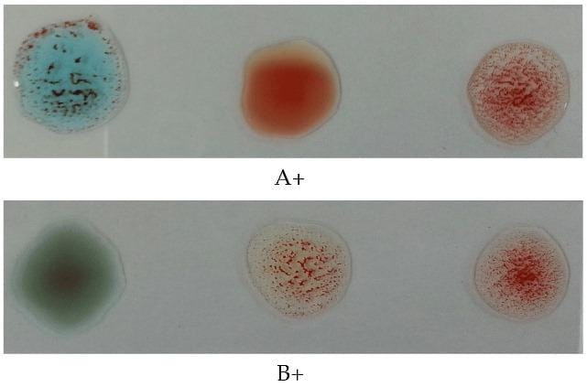
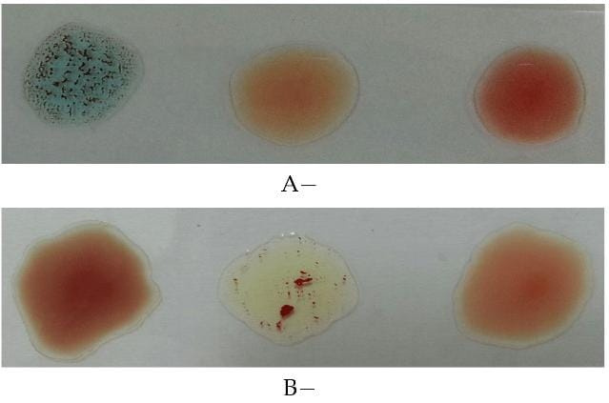
Literature Review.
- Jashwanth Sai Ganta., Dr. Mohana Roopa Y., Mary Rishitha, R. (2024).BloodGroup Detection Using Image Processing and Deep Learning. International Research Journal of Engineering and Technology (IRJET), 11(4). Retrieved from https://www.irjet.net/archives/V11/i4/IRJET-V11I416.pdf
T. Ratnamala and M. Y. Hussain, “Blood Group Detection Using Image Processing,”.
3

Slide 5
Literature Review.
V. Patil and D. R. Ingle, “Correlation of Blood and Lifestyle: Analysis Through Fingerprint Patterns,”
F. I. N., F. N., and I. A. H., “Blood Group Detection Using Fingerprint,”.
3

Slide 6
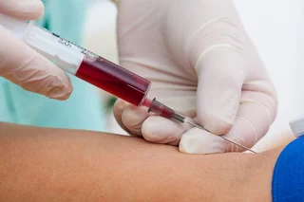
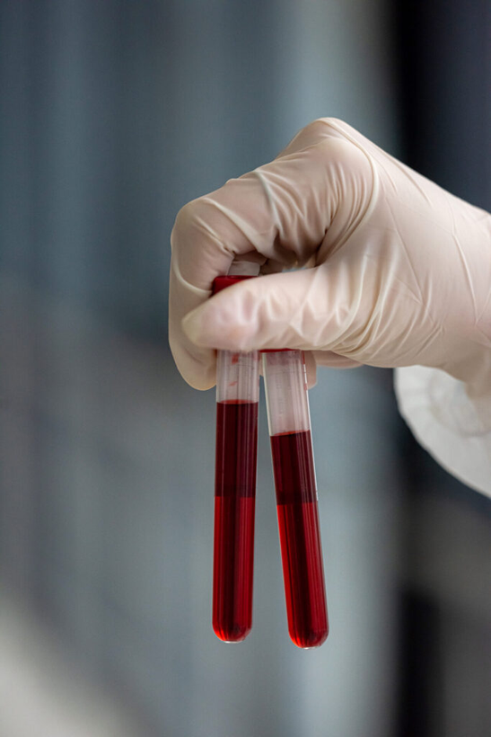
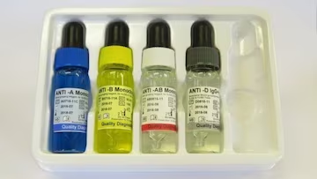
Existing System

Slide 7
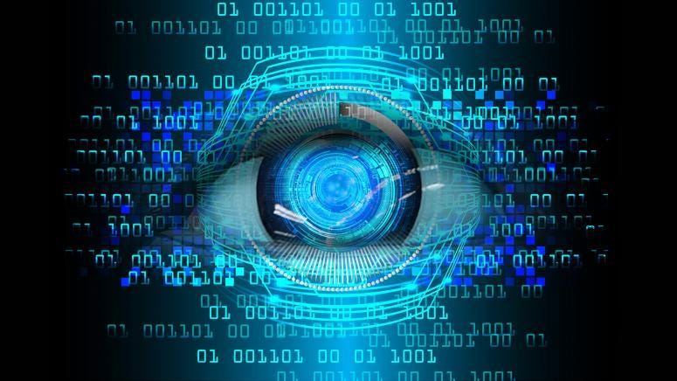
Proposed system

Slide 8
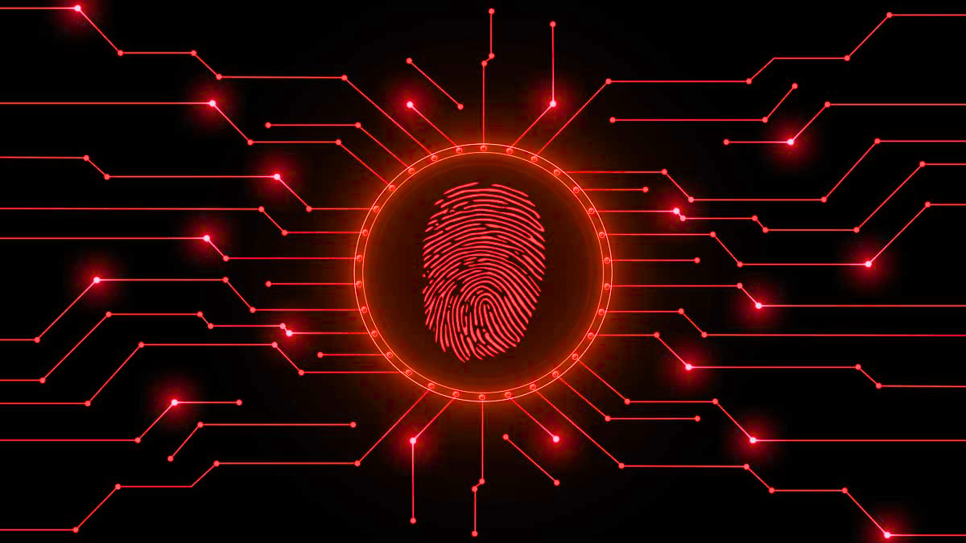
OBJECTIVES
Develop a deep learning model to classify fingerprints into 8 blood groups.
Use image processing to train the dataset.
Achieve good accuracy and validate performance.

Slide 9

TOOLS & TECHNOLOGIES
Python (TensorFlow, Keras, Matplotlib)
Google Colab (GPU-powered training)
Dataset: Fingerprint images categorized into 8 classes (A+, A-, B+, B-, AB+, AB-, O+, O-)
Model: Convolutional Neural Network (CNN)

Slide 10
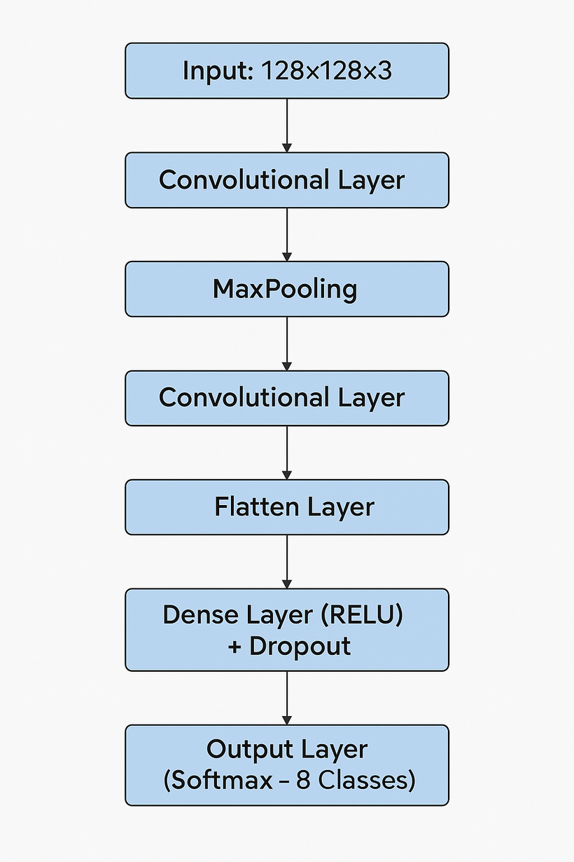
MODEL ARCHITECTURE

Slide 11
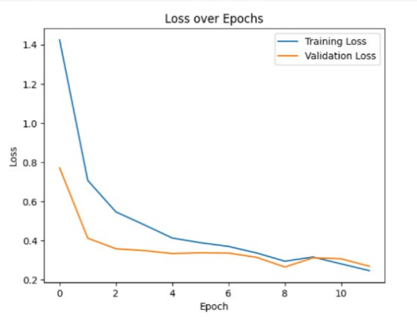
RESULTS AND GRAPHS
Final Accuracy: 0.9048 (mention your result)
Validation Loss : 0.267
Validation Accuracy : 0.8989

Slide 12
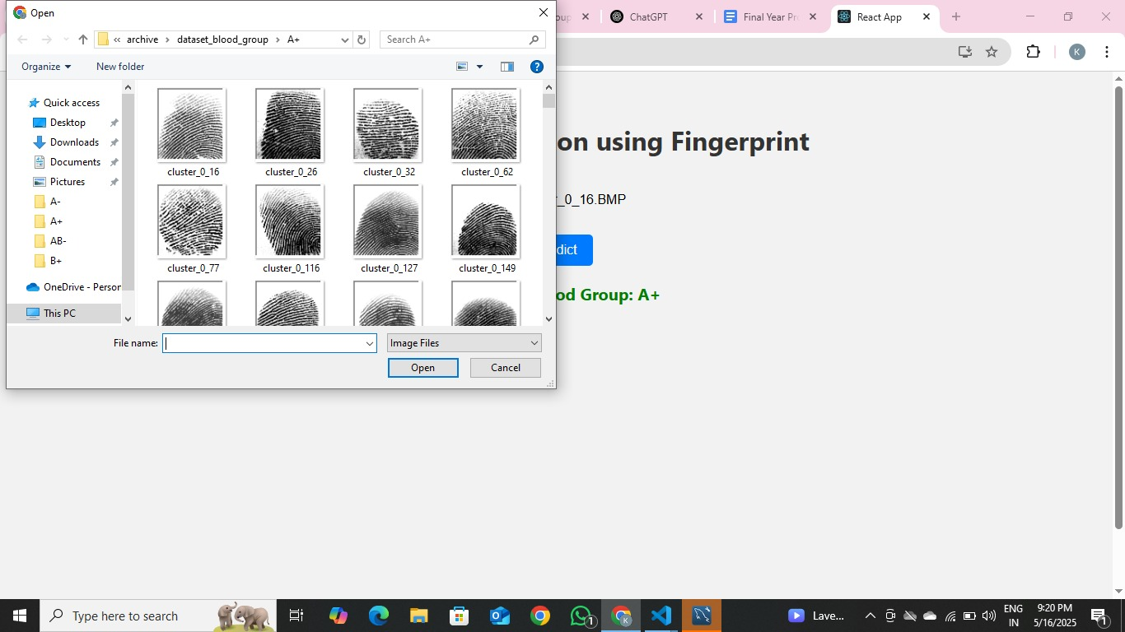
RESULTS

Slide 13
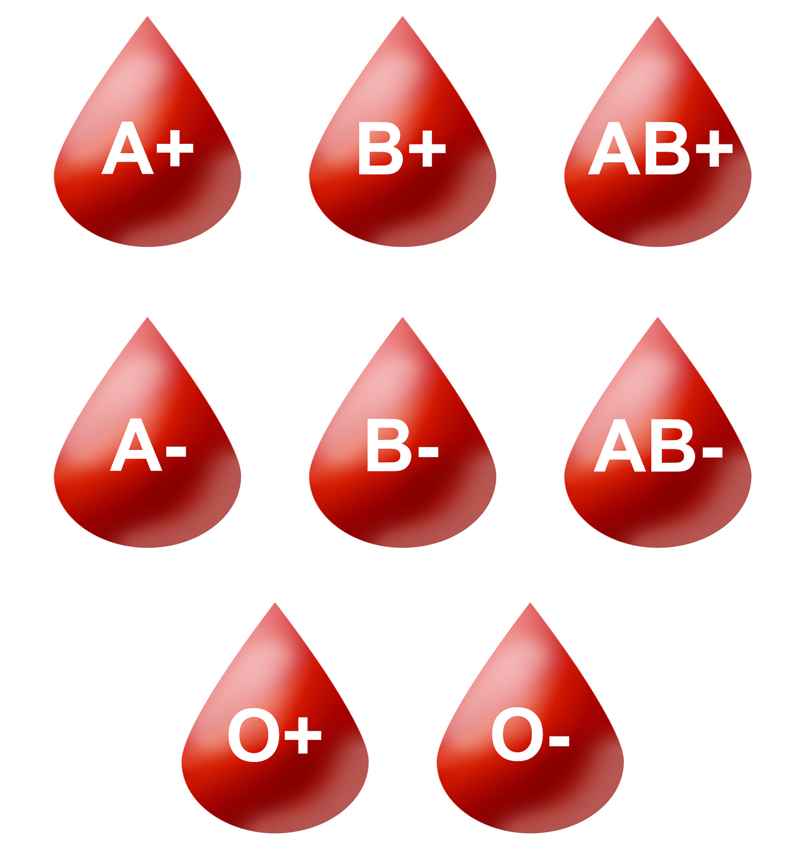
Conclusion
The fingerprint-based blood group detection system offers a non-invasive, fast, and accurate alternative to traditional methods by utilizing image processing, machine learning, and a user-friendly interface. Designed for reliability, scalability, and ease of use, it is practical for applications like healthcare, emergencies, and blood donation camps. With proper testing and deployment, this system could revolutionize blood group identification, benefiting medical professionals and individuals
alike.
9

Slide 14
THANK YOU
For Listening

